Slide 1
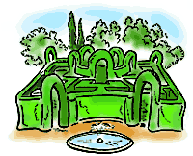
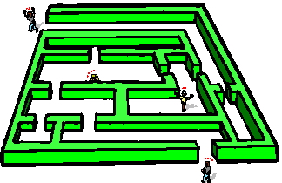
MAZE GAME
Presented by
PRASHANTH C(1GA14CS093)
Under the guidance of
Mrs. Sowmya M
(Assistant Professor)
DEPARTMENT OF
COMPUTER SCIENCE & ENGINEERING
GLOBAL ACADEMY OF TECHNOLOGY

Slide 2

CONTENTS
Abstract
Introduction
System Requirements
User Defined Functions
Detailed Design
Implementation
Testing and Results
Conclusion
Future Enhancement
References

Slide 3
ABSTRACT
The aim of the mini project is to implement the path finding game. The user must plot out a path where he can move from the starting point to the ending point in the maze.
The game contains a rectangular maze. The subject can only travel in the path specified and should never cross through the walls.
As soon as the subject completes the maze successfully a window pops up asking the user to quit to main menu or restart the game.
The game has both mouse and keyboard interface. The movement of the subject is through arrow keys. The maze game employs transformation function.

Slide 4
INTRODUCTION
Computer Graphics is concerned with all aspects of producing pictures or images using a computer. We can create images that are indistinguishable from photographs of real objects. In other terms, Computer Graphics are the graphics created by the computers, and more generally, the representation and manipulation of image data by a computer.
OpenGL is a software interface to graphics hardware. The OpenGL specification describes an abstract API for drawing 2D and 3D graphics. OpenGL is an evolving API. New versions of the OpenGL specification are regularly released by the Khronos Group, each of which extends the API to support various new features.
GLUT is the OpenGL utility toolkit, a window system independent toolkit for writing OpenGL programs. It implements a simple windowing API for OpenGL.
The OpenGL API is typically used to interact with a GPU, to achieve hardware-accelerated rendering. It is widely used in CAD, virtual reality, scientific visualization, information visualization, flight simulation, and video games.

Slide 5
SYSTEM REQUIREMENTS
Hardware requirements
128 MB RAM or Higher
1.2Ghz or Higher processor
Tools/Software requirements
Microsoft Visual Studio/CodeBlocks
OpenGL
Platform requirement
Windows

Slide 6
USER DEFINED FUNCTIONS
build_row: This function creates horizontal lines in the maze.
build_col: This function creates vertical lines in the maze.
write: This function writes the string on the screen.
startscreen: This function creates the start screen of the maze game which consists of LEVEL 1, QUIT,LEVEL 2.
startgame: It is called when the user has chosen the level. It goes to the chosen level.
draw: This function first checks the value in the array,if the value is 1 then it does nothing and if the value is 0 then it increments the coordinates of the object to move it and then calls the display function.
arrowkeys: This function uses the direction keys (up, down, left, right) to move the object in the desired direction. It first checks the level of the maze and then increments or decrements the variables accordingly and then calls the draw().

Slide 7
DESIGN
START
Welcome screen()
Menu screen()
Rule screen()
Game screen()
MAZE
KEYspl()
MOUSEip()
READING INPUT LEFT/RIGHT/UP/DOWN/MOUSE
END OF INPUT
false
Win()/ loose()
Display
STOP

Slide 8
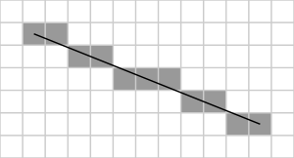
IMPLEMENTATION
The working of the program can be illustrated by the Bresenham Algorithm
It aims at implementing integer based calculations for determining the pixel co-ordinates. The common conventions are
  That pixel coordinates increase in the right and down directions (e.g. that the pixel at (1,1) is directly above the pixel at (1,2)), and
  That the pixel centers have integer coordinates.
Bresenham's algorithm chooses the integer y corresponding to the pixel center that is closest to the ideal (fractional) y for the same x; on successive columns y can remain the same or increase by 1.
Bresenham’s Line Algorithm

Slide 9
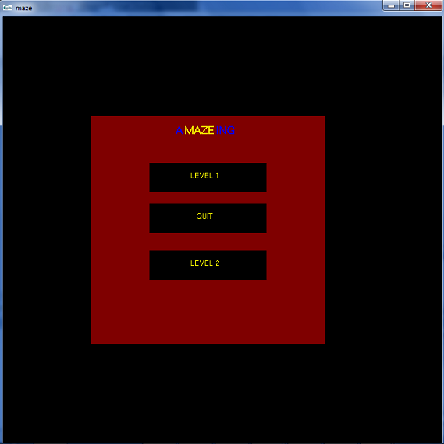
TESTING AND RESULTS
Start Screen

Slide 10
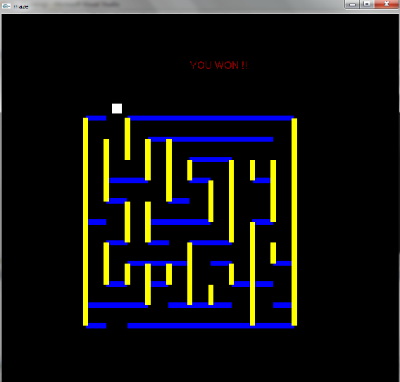
TESTING AND RESULTS
Level 1

Slide 11
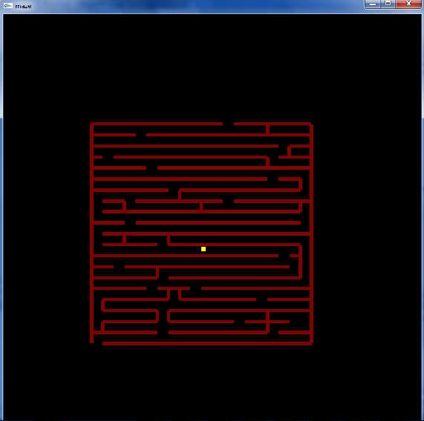
TESTING AND RESULTS
Level 2

Slide 12

CONCLUSION
This is a simple interactive application. It has an open source code and no security features has been included.
The user is free to alter the code for future enhancement. Checking and verification of all possible types of the functions are taken care
The user-friendly interface allows the user to interact with it very effectively.

Slide 13

FUTURE ENHANCEMENT
The “MAZE GAME” project has been made in such a way that a number of changes can be done.
The following features can be incorporated
  The front end design can also be
  changed if programmer wishes
  A simple digital timer can be implemented
  Better graphical features for the shape of the object which traverses through the maze can be used

Slide 14
REFERENCES
BOOKS:
Edward Angel, “Interactive Computer Graphics”,5th edition, Pearson Education,2005
F.S.Hill and Stephen M.Kelly,”Computer Graphics using OpenGL”, 3rd edition.
WEBSITES:
http://www.glprogramming.com/red/chapter08.html
http://pyopengl.sourceforge.net/documentation/manual/
http://en.wikibooks.org/wiki/OpenGL_Programming/Modern_OpenGL_Introduction

Slide 15


